Slide 1



GRIDS Tutorials
Interrupted Time Series Design
gridsusc.github.io

Slide 2

Follow Along
Follow along with the workshop by cloning the GitHub repository
https://github.com/gridsusc/GRIDS-Tutorials/the_rest_of_the_URL

Slide 3


Introduction
Matheus Schmitz
Undergrad Exchange Student
MS Applied Data Science
Machine Learning TA
Research @ Information Sciences Institute
Student Ambassador
Shout-out to Keith and Goran!

Slide 4


Quasi-Experimental Methods
Define your study group
Interrupted Time Series
????
Double-blind randomized control trials
Sometimes you can’t force an experiment
A/B tests
Quasi-Experimental Methods
Profit

Slide 5
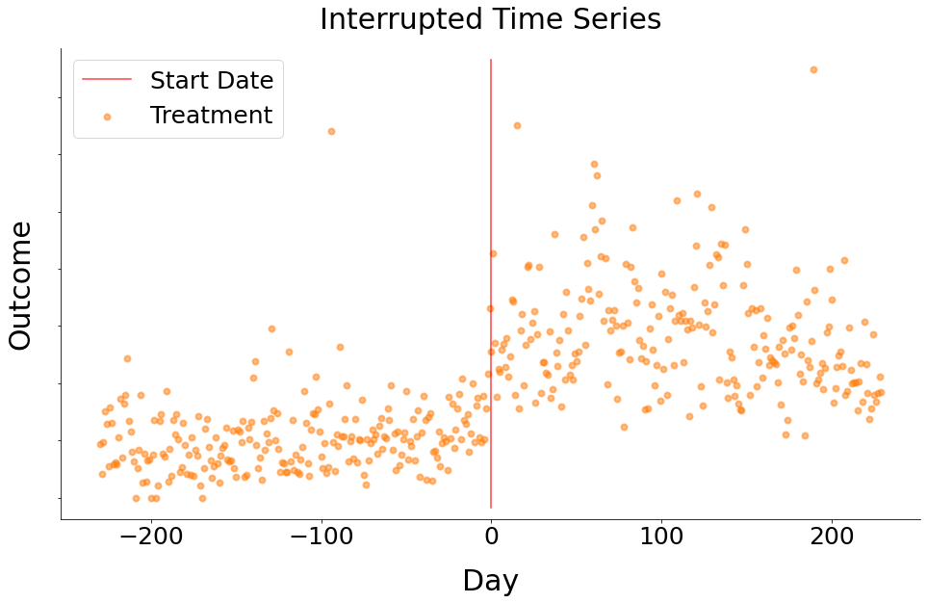
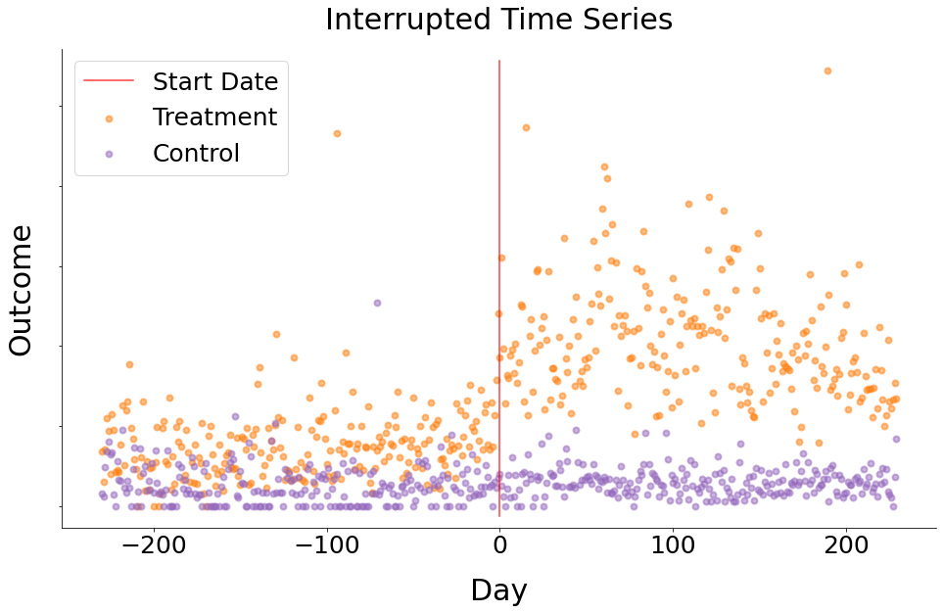
Interrupted Time Series
Model the treatment group over time
Allow the model to “break” at the beginning of treatment
The larger the gap outcome is, the larger the break
This can be made more robust by adding a control group
Also known as Regression Discontinuity

Slide 6
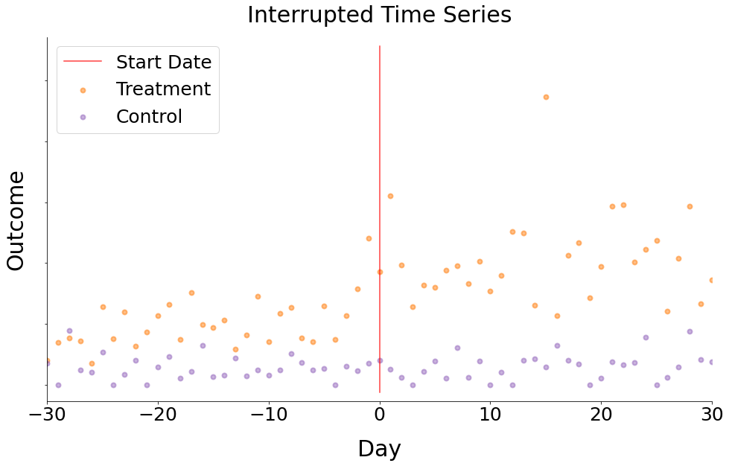
How Many Days to Use?
10-day bandwidth
[T @-1 Truth, C @-1 Truth]
[T @-1 Pred, C @-1 Pred]
day -1

Slide 7
How Many Days to Use?
10-day bandwidth
[T @-1 Truth, C @-1 Truth, T @-2 Truth, C @-2 Truth]
[T @-1 Pred, C @-1 Pred, T @-2 Pred, C @-2 Pred]
day -2

Slide 8
How Many Days to Use?
10-day bandwidth
How many days back to go?
For my data I tested 10, 20, 30, …,100 days (folds) and after ~50 folds results are stable
day -3

Slide 9
How Many Days to Use?
15-day bandwidth
day -3

Slide 10
How Many Days to Use?
20-day bandwidth
day -3

Slide 11
Designing the ITS
Time = The day
Exposed = 0 if Control, 1 if Treatment
Interrupted = 0 if before Treatment/Placebo, 1 if after
Interaction Terms = Incremental effects

Slide 12
Interpreting ITS
Feature | Meaning
const | The pre-treatment baseline for the control group
time | The pre-treatment trend for the control group
exposed | The incremental baseline for the treatment group
interrupted | The incremental baseline after treatment/placebo administration
time_x_exposed | The incremental trend for the treatment group
time_x_interrupted | The incremental trend after treatment/placebo administration
exposed_x_interrupted | The incremental baseline after treatment/placebo administration
time_x_exposed_x_interrupted | The incremental trend for the treatment group after treatment administration

Slide 13
Interpreting ITS
Effect Size
exposed_x_interrupted = The effect size from applying the treatment.
Baseline Values
const = The pre-treatment baseline for the control group.
const + exposed = The pre-treatment baseline for the treatment group.
const + interrupted = The post-treatment baseline for the control group.
const + interrupted + exposed = The post-treatment baseline for the treatment group.
Trends
time = The pre-treatment trend for the control group.
time + time_x_exposed = The pre-treatment trend for the treatment group.
time + time_x_interrupted = The post-treatment trend for the control group.
time + time_x_exposed + time_x_interrupted + time_x_exposed_interrupted = The post-treatment trend for the treatment group.

Slide 14
Sensitivity Analysis
What if I picked the wrong number of days?
How would my analysis look like if I had used a different bandwidth?
Let’s plot the coefficients over all bandwidths

Slide 15
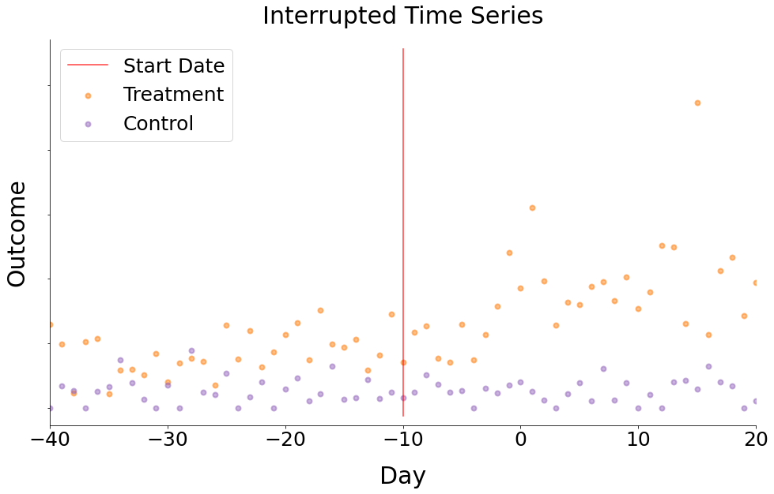
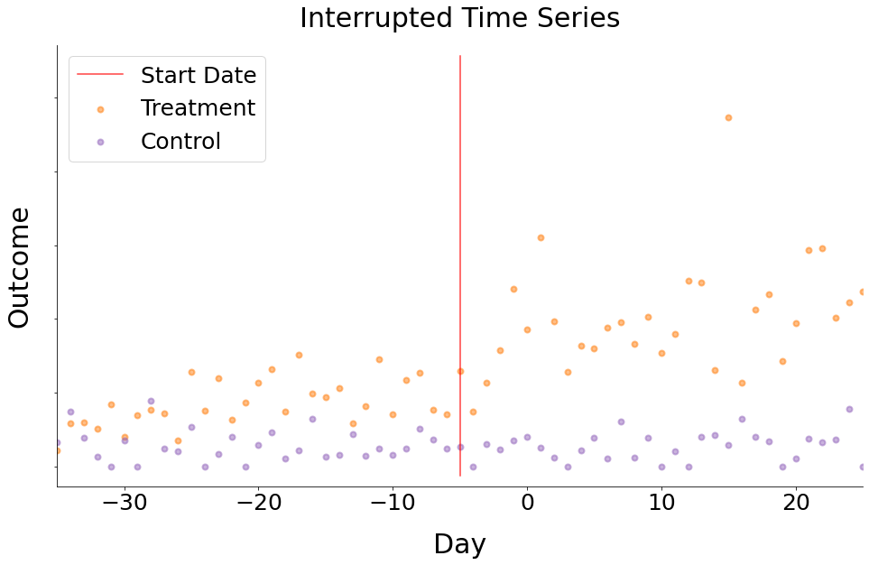
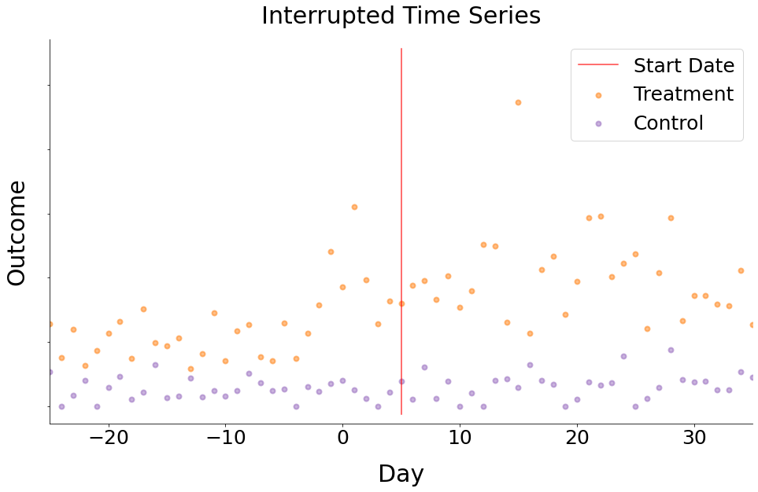
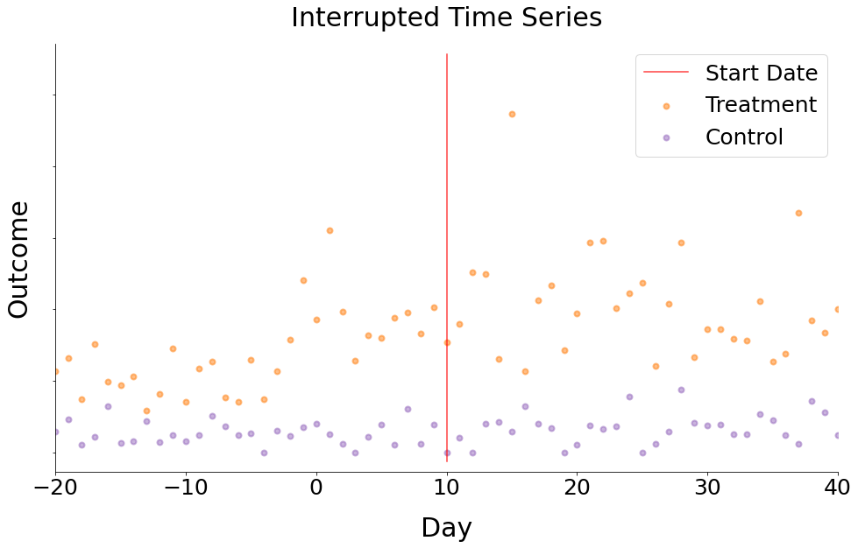
Falsification (Placebo) Tests
What if my start date is wrong or meaningless?

Slide 16
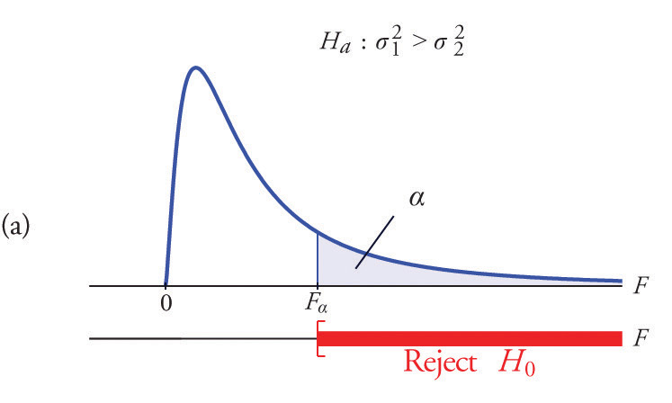
Falsification (Placebo) Tests
How to measure this?
Search for structural breaks in the data
Wald Test
Wald Test
The Wald test works by testing the null hypothesis that a set of parameters is equal to some value. In the model being tested here, the null hypothesis is that the coefficients are simultaneously equal to zero (i.e. the whole model is useless).
To give you an intuition about how the test works, it tests how far the estimated parameters are from zero (or any other value under the null hypothesis) in standard errors, similar to the hypothesis tests typically printed in regression output. The difference is that the Wald test can be used to test multiple parameters simultaneously, while the tests typically printed in regression output only test one parameter at a time.
If the test fails to reject the null hypothesis, this suggests that removing all variables from the model will not substantially harm the fit of that model, since a predictor with a coefficient that is very small relative to its standard error is generally not doing much to help predict the dependent variable.
The test takes into account not only the variances of the individual coefficient estimates but also the covariances among them, which is important with correlated predictors that typically are found in practice.
Likelihood Ratio Test
Lagrange Multiplier Test

Slide 17
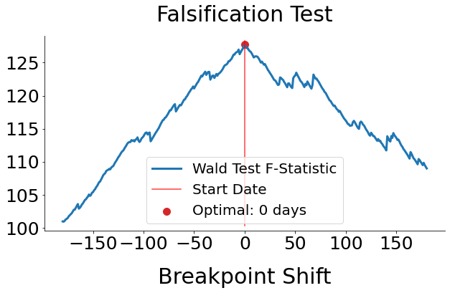
Falsification (Placebo) Tests

Slide 18
Falsification (Placebo) Tests
Thank you!

